Slide 1
Navigating EUDAMED
Streamlined Compliance for EU MDR & IVDR Success

Slide 2

Agenda
Why UDIs and EUDAMED matter
Global UDI perspective
EUDAMED – Introduction + Timelines
EUDAMED Actor Registrations
EUDAMED Device Registrations
Special cases: importers and legacy devices
EUDAMED Submission options
Ongoing responsibilities
UDI Compliance Across Multiple Regions
Key Takeaways

Slide 3
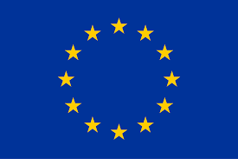





Why this Matters
A Real-World Scenario
Issue:
Non-compliant labeling and/or missing information in EUDAMED
Consequences:
Delayed patient access – treatment interruptions or postponed procedures
Lost revenue – products stuck at customs, missed sales windows
Compliance findings – potential regulatory actions, reputational damage
Foreign manufacturer
Point of putting device into service/Point of use
EUDAMED
Regulation (EU) 2019/1020
Market Surveillance & Compliance of Products
Poll 1

Slide 4
Global UDI perspective - Origins
Early 2000s:
Concerns grew over patient safety incidents linked to the inability to quickly trace defective medical devices.
Regulators and healthcare stakeholders began considering a system to uniquely identify devices, similar to barcoding in the pharmaceutical sector.
Timeline | USA | International | EU
2007–2012 | FDAAA 2007, FDASIA 2012 – FDA authority established | IMDRF UDI Working Group (2012) | –
2013 | FDA Final UDI Rule published | IMDRF global UDI guidance | –
2014–2018 | Phased rollout by class (III→II→I) | Japan & Korea start UDI programs | –
2017 | – | – | MDR & IVDR introduce UDI + Basic UDI-DI
2019 | – | China launches UDI pilot (high-risk implants) | –
2021 | Full FDA coverage (Class I & Unclassified) | Korea expands; Japan aligns | MDR in force (May 2021)
2022–2024 | GUDID updates |  | IVDR in force (2022); Introduction Master UDI-DI
2025–2028 | – | Global rollout continues (China, Korea, Australia) | Full EU UDI/EUDAMED by 2028

Slide 5
Global UDI perspective - Definitions
Unique Device Identification System (UDI System):
A globally harmonized system ensuring positive identification of medical devices throughout distribution and use.
Key elements:
  Devices must carry a globally unique UDI on their label.
  The UDI is presented via AIDC (automatic data capture) and, if needed, HRI (human-readable interpretation).
  The UDI-DI is linked to a jurisdiction-specific public UDI database.
Objective:
  Prevent counterfeiting and fraud
  Facilitate efficient device recalls when necessary
  Improve post-market surveillance for better safety monitoring
  Ensure seamless tracking of devices from production to patient usage
Issuing Agency/Entities:
Organization accredited by a regulatory authority to operate a system for the issuance of UDIs (e.g. GS1, HIBCC, ICCBBA, IFA).

Slide 6
Global UDI perspective – UDI Databases
Territory | UDI Issuing Entities | UDI Database | Type of UDI Data Required | # UDI data attributes
EU (MDR/IVDR) | GS1, HIBCC, ICCBBA, IFA | EUDAMED | Basic UDI-DI and UDI-DI incl. Master UDI-DI | ≈ 130
Australia (TGA) | GS1, HIBCC, ICCBBA | AusUDID | UDI-DI | Similar to US
Japan (PMDA/MHLW) | GS1, HIBCC, ICCBBA | N/A | UDI-DI | N/A
Brazil (ANVISA) | GS1, HIBCC, ICCBBA | SIUD | UDI-DI | ≈ 21
Canada (Health Canada) | TBD | N/A | Expected: UDI-DI | N/A
USA (FDA) | GS1, HIBCC, ICCBBA | GUDID | UDI-DI | ≈ 64
UK (MHRA) | TBD | N/A | Expected: UDI-DI | N/A
Switzerland (Swissmedic) | GS1, HIBCC, ICCBBA, IFA | swissdamed | Same as EU MDR/IVDR model | Aligned to the EU, a few CH fields and some data fields are excluded for CH.

Slide 7

Global UDI perspective – Timelines
Europe (EU MDR/IVDR)
EUDAMED: Q1 2026 (?)
Class III
Class IIa and Class IIb
Class D (IVD)
Class I,
Class B and C (IVD)
Class A (IVD)
Australia (TGA)
AusDID: 1 July 2026
Class III and IIb
Class IIa
Class Is
Japan (PMDA)
All classes
Brazil (ANVISA)
Class IV
Class III
Class II
Class I
Canada (Health Canada)
USA (FDA)
GUDID fully active
Class III
Class II life-sustain and implantables
Class II
Class I
United Kingdom (MHRA)
Switzerland (Swissmedic)
Swissdamed: 1 July 2026
Class III
Class IIa and Class IIb
Class D (IVD)
Class I,
Class B and C (IVD)
Class A (IVD)
2014
2016
2018
2020
2022
2024
2026
2028
Poll 2
Note: Direct marking timelines can be different

Slide 8
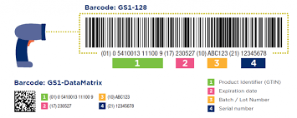
Global UDI perspective - Definitions
Unique Device Identifier (UDI) :
series of numeric or alphanumeric characters that is created through a globally accepted device identification and coding standard. It allows the unambiguous identification of a specific device on the market.
It consists of two parts:
  UDI-DI (Device Identifier): identifies the specific device model/version.
  UDI-PI (Production Identifier): identifies production details (e.g., lot number, serial number, expiry date, manufacturing date, software identification).
UDI-PI Rules
If lot number, serial number, software ID, or expiry date is on the label → must be included in the UDI-PI.
If manufacturing date is present together with other identifiers → it does not need to be in the UDI-PI.
If manufacturing date is the only identifier → it shall be used as the UDI-PI.

Slide 9

Global UDI perspective - Definitions
When is New UDI-DI required?
A new UDI-DI is needed for any change that risks misidentification or ambiguity in traceability, specifically if any of these elements change:
  Name or trade name
  Device version or model
  Single-use status
  Sterile packaging
  Need for sterilization before use
  Quantity per package
  Critical warnings/contraindications (e.g., contains latex or DEHP)
Source: Annex VI, Part C of the MDR and IVDR.
A new UDI-DI is also required in case of :
  Changes to the intended purpose of a device
  Changes to indications for use of the device
  Changes to the performance of a device
IMPORTANT: A UDI-DI is only allowed to be associated with 1 Basic UDI-DI.

Slide 10

Global UDI perspective - Definitions
UDI carrier
The UDI carrier is the means of conveying the UDI by using AIDC and, if applicable, its HRI.
  AIDC: Automatic identification and data capture
  HRI: Human Readable Interpretation – legible interpretation of data characters encoded in the UDI carrier.
Linear barcode, 2D/Matrix bar code, RFID (Radio Frequency Identification)
      Symbol to be used when multiple data carriers are present on the label.
Basic UDI-DI :
Introduced under MDR Article 27 /IVDR Article 24.
Primary identifier of a device model.
It is the main key for records in the UDI database
Referenced in relevant regulatory documents (e.g. certificates and EU declarations of conformity, technical documentation, and summary of safety and clinical performance)
Linked to devices with the same intended purpose, risk class, and essential design and manufacturing characteristics.
Only regulatory identifier, not a supply chain identifier (i.e. not included on the product labeling)
Notes:
Annex VI, Part C, Section 1 includes definition of Basic UDI-DI

Slide 11
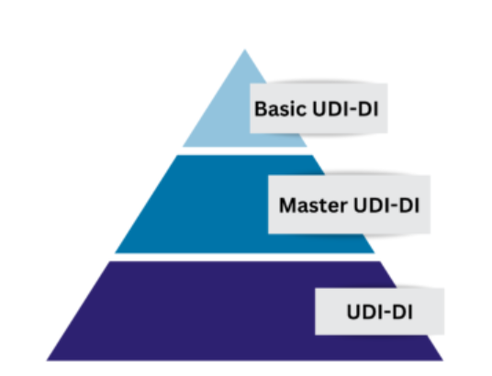
Global UDI perspective - Definitions
Master UDI-DI :
Introduced with Regulation 2023/2197 “assignment of Unique Device Identifiers for contact lenses”
Applicable for highly individualized regulation devices that share specific similarities with respect to clinically relevant parameters:
  Contact lenses
  Spectacle frames/lenses, ready readers
Introduced to reduce the number of entries in the EUDAMED (European Database on Medical Devices) registration system.
Timelines:
EUDAMED: mandatory Q1 2026 (planned)
Master UDI-DI mandatory:
  Contact lenses: 9 November 2026
  Spectacle frames, spectacle lenses and ready-to-wear reading spectacles: September 2028
See MDCG 2025-7 for details.

Slide 12
UDIs – packaging level requirements
Shipper
Logistic unit
No UDI or Package DI
Tray
Tertiary package
Package DI required
Carton
Secondary package
Package DI required
Peel Pouch
Primary package / Base package
Primary UDI
The “Key“ in UDI databases incl. EUDAMED
In EU linked to 1 Basic UDI-DI
UDI Requirements:
A UDI shall be assigned to the device itself or its packaging.
Higher levels of packaging shall have their own UDI.
Systems and procedure packs as referred to in MDR Article 22 shall be assigned and bear their own UDI.
Base package that contains more than 1 device → Unit of Use DI (UoU DI) to be assigned as virtual identifier to enable to associate a device to or on a patient.

Slide 13
EUDAMED - Introduction
Regulatory framework:
EU MDR (EU 2017/745) – applicable since 26 May 2021
EU IVDR (EU 2017/746) – applicable since 26 May 2022
EU 2024/1860 (Gradual roll-out of EUDAMED) – applicable since 13 June 2024
  Modules can be released once audited and declared functional (no need to wait for all 6 modules to be completed)
  Mandatory use of a module 6 months after publication of the notice in the Official Journal of EU (OJEU)
Finalization of Minimum viable product development
Independent audit on module
Consultation with MDCG on final audit report(s)
Publication of the notice of functionality in OJEU
Mandatory use of module

Slide 14



EUDAMED – 6 Modules
Actor module (ACT)
Available for voluntary use
UDI/Device module (UDI/DEV)
PR (SPP producer)
Notified bodies and certificates module (NB/CRF)
Notified Body + European Commission
Clinical investigations/performance
studies module (CI/PS)
Sponsor + Competent Authority
Under development
Post-market surveillance and Vigilance module (VGL)
Market surveillance module (MSU)
Competent Authority + European Commission
Poll 3- 6

Slide 15
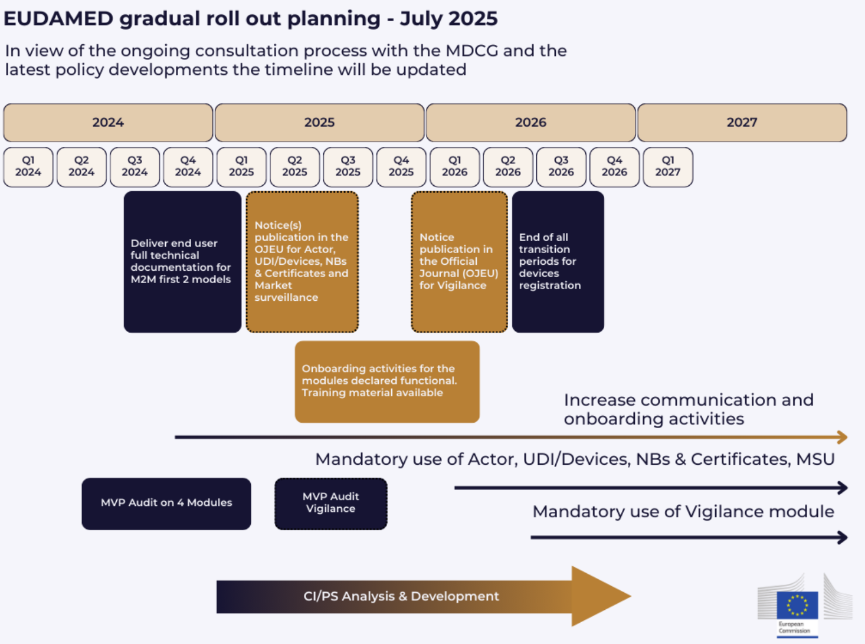
EUDAMED – Timeline
Current status
Planned date of July 2025 of notice of functionality in OJEU or the Actors, UDI/Device Registration and Notified Bodies and Certificates not met.
→ EUDAMED will not be mandatory from Jan 2026, but Q1 can still be met.
Be proactive — prepare your EUDAMED compliance before it becomes urgent
EUDAMED currently includes:
Manufacturers: >28,000
Authorized Representatives: >2,500
Importers: >9,000
System and Procedure Pack Producers: >1,300
Devices / Systems / Procedure Packs: >82,100
Certificates: > 1450

Slide 16
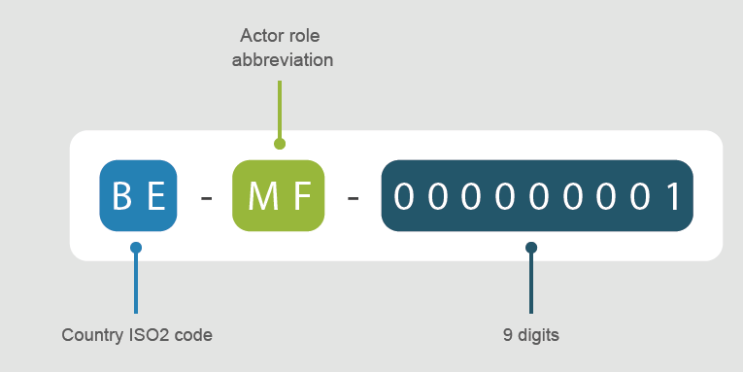
EUDAMED Actor Registrations
Mandatory EUDAMED Actor Registration
  Manufacturers
  System/Procedure Pack Producers
  EU Authorized Representatives
  Importers
Excluded from Actor Registration
  Distributors (economic operators, but not considered “Actors” under MDR)
Steps to register as Actor:
Create EUDAMED account
Submit Actor registration request in EUDAMED
EAR verifies registration request
National Competent Authority issues Actor ID/SRN after approval
MDR-Eudamed - Welcome to EUDAMED
For non-EU manufacturers only

Slide 17
EUDAMED Actor Registrations
EUDAMED Actor Registration – Required Documents
Organisation name (+ optional abbreviation), address (incl. country) and contact details
Organisation identifiers (VAT, EORI, National Trade Register, if applicable)
Organization Identification Document – confirms identity of organization
Declaration on Information Security Responsibilities
Person Responsible for Regulatory Compliance (PRRC) – for manufacturers & EARs
EUDAMED Mandate Form
Responsible EAR (for non-EU manufacturers) and Competent Authority
Responsible Competent Authority:
For EU Manufacturers → CA = location of the Actor
For non-EU Manufacturers → CA = location of the Authorised Representative (AR)
For non-EU SPP producers → CA = where the first SPP is placed on the EU market

Slide 18
EUDAMED Actor Registrations
Actor Registration – Common Rejection Issues
Incomplete or Incorrect Documentation
  Missing Organization Identification Document
  Incorrect or missing Mandate Summary Document (for non-EU manufacturers)
  Missing Declaration on Information Security Responsibilities
Data Inconsistencies
  Mismatch between company name/address in documents vs. online submission
  Wrong VAT / EORI / National Trade Register numbers
  Incorrect or missing Competent Authority selection
  Starting date of EAR Mandate not identical in EUDAMED and Mandate provided
Authorized Representative Issues
  AR not properly mandated or mandate form incomplete
  Conflicting AR information for a non-EU manufacturer
PRRC (Person Responsible for Regulatory Compliance)
  PRRC not identified or insufficient details provided
  Missing multiple PRRC entries if more than one exists in the organization
Process Issues
  Submission not confirmed/validated by the Authorized Representative (for non-EU manufacturers)
  Competent Authority requests corrections not addressed in time

Slide 19
EUDAMED Device Registrations
Requirement | MDR | IVDR
Submit Basic UDI-DI | Art. 29(1), Annex VI Part B | Art. 26(1), Annex VI Part B
Link to CE certificate | Art. 29(3) | Art. 26(3)
Submit metadata | Annex VI, Part A & B | Same
Use correct EMDN code | Art. 26 | Art. 23
UDI Requirements under MDR & IVDR
Each device/IVD must be uniquely identifiable and traceable in EUDAMED.
  Datafields related to the Basic UDI-DI
  Datafields related to the UDI-DI
In total ≈ 130 datafields to be completed per device (Basic UDI-DI + UDI-DI)

Slide 20
EUDAMED Device Registrations
EUDAMED UDI/Device Roles & Access
Viewer
  View all UDI/Device data (incl. Drafts) of own organization
  View Registered data from other organizations
  CAs/DAs/NBs/EC may also view submitted data
  Registered data is publicly available
Proposer
  Create and delete UDI/Device drafts
  Has Viewer rights
Confirmer
  Submit UDI/Device drafts for registration
  Has Proposer + Viewer rights

Slide 21
EUDAMED Device Registration
Differences between Legacy and Regulation devices
Aspect | Legacy | Regulation (MDR/IVDR)
Identification | EUDAMED DI (no Basic UDI-DI) (Identifier with prefix “B-”) | Basic UDI-DI + UDI-DI
UDI/Device ID | May have UDI-DI, otherwise EUDAMED ID (Identifier with prefix “D-”) | UDI-DI registered under Basic UDI-DI
Certificate Information | Provided by manufacturer in UDI/Device module (only NB, certificate ID & expiry date) | Provided by NB in NB & Certificates module (some info still needed in UDI/Device module for high-risk devices)
Device Linking | One (1) device per EUDAMED DI | Multiple devices/SPPs can share one Basic UDI-DI (i.e. multiple UDI-DIs under same Basic UDI-DI)

Slide 22

EUDAMED Device Registration - BUDI
Topic | Field | All | Medical Device | IVD | SPP
Actors | Manufacturer SRN
 | Authorized Representative SRN
Device Identification | Basic UDI-DI / EUDAMED DI
 | Issuing Entity
Regulatory information | Legislation
 | Risk Class (highest in SPP)
Device Information | Device Model
 | Device Name
 | Special Device
 | System / Pack
 | Kit (Y/N)
Device Characteristics | Animal Tissue/Cell
 | Human Tissue/Cell
 | Active Device
 | Implantable
 | Measuring
 | Reusable Surgical
 | Administers Medicinal Product
 | Contains Medicinal Product
 | Human Blood or Plasma Derivative
 | Suture, Staple, Filler, Tissue Adhesive, etc. (Class IIb implantable WET)

Slide 23
EUDAMED Device Registration - BUDI
Topic | Field | All | Medical Device | IVD | SPP
Device Characteristics | Reagent
 | Instrument
 | Companion Diagnostic
 | Near Patient Testing
 | Patient Self-Testing
 | Professional Use IVD
 | Microbiological Tissue/Cell
Certificates (if applicable) | Certificate Type
 | Certificate Number
 | Certificate Revision Number
 | Certificate Date
 | Certificate Notified Body Number
Clinical Investigation (if applicable) | Clinical Investigation Number
 | Clinical Investigation Link
 | Clinical Investigation Non-EU Countries

Slide 24
EUDAMED Device Registration - UDI
Topic | Field | All | Medical Device | IVD | SPP
Device Identification | Basic UDI-DI
 | (M) UDI-DI, (M) Issuing Entity
 | (M) Secondary UDI-DI, (M) Issuing Entity
 | Unit of Use (UoU) UDI-DI, Issuing Entity
 | Direct Mark (DM) UDI-DI, Issuing Entity
 | Related Legacy Device
 | Relationship Type
Device Information | Nomenclature Code
 | Trade Name
 | Reference/Catalog Number
 | Product Description
 | Information URL
 | Base Device Quantity
 | Production ID Type
 | Device Status
 | Member State Place on Market
 | Member States Made Available, Start & End Dates
 | Non-medical Purpose
 | New Device (y/n)

Slide 25
EUDAMED Device Registration - UDI
Topic | Field | All | Medical Device | IVD | SPP
Device characteristics | Critical Warning/Contraindications Type, Text
 | Storage & Handling Type
 | Storage & Handling Description
 | Labelled Single Use (y/n)
 | Maximum Number of Reuses
 | Labelled Sterile (y/n)
 | Sterile Required for Use (y/n)
 | Animal Tissue/Cell
 | Human Tissue/Cell
 | Reprocessed Single-Use Device (y/n)
 | Contains Latex (y/n)
 | CMR Substance Type, Name, CAS#, EC#
 | Endocrine Disruptor Name, CAS#, EC#
 | *Medicinal Type, Name, INN
Packaging | Package UDI-DI
 | Package UDI-DI, Issuing Entity
 | Package Contain UDI-DI
 | Package Level Quantity
 | Package Status
Poll 7 + 8

Slide 26
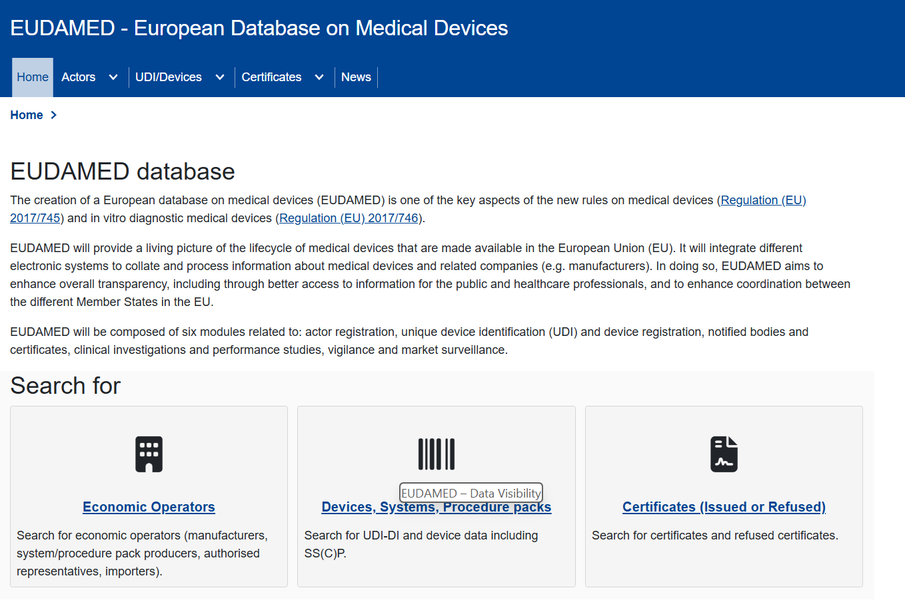

EUDAMED – Data Visibility
Not all submitted information is publicly available in EUDAMED
EUDAMED Data Dictionary specifies which fields are public, restricted, or confidential
Field | Public? | Notes
Basic UDI-DI | Yes | Core identifier
UDI-DI | Yes | Device-level information
UDI-PI | No | Not uploaded (confidential)
SSCP | Yes | Required for Class III & implantables
Actor name & SRN | Yes | Legal information only
EUDAMED

Slide 27
Special cases: Importers
Verification of Device Registration
  Before placing a device on the market, importers must verify that:
    The manufacturer (and if applicable, the AR) is registered in EUDAMED.
    The device and its UDI-DI are correctly registered in the UDI/Devices module.
  If the device is not registered, the importer must not place it on the market.
Traceability of Economic Operators
  Importers must ensure that their details (name, address, SRN) appear in EUDAMED records linked to the devices they import. This provides traceability of the supply chain in EUDAMED.
Labeling Cross-Check
  Importers must check that:
    UDI-DI and Basic UDI-DI on labeling match the entries in EUDAMED.
    Importer’s details are properly indicated on the device or packaging (per Article 13 MDR).
  Discrepancies can trigger customs issues or NC findings.

Slide 28
Special cases: Legacy devices
Registration Requirement
  Legacy devices must be registered in EUDAMED even though they do not have a Basic UDI-DI (MDR Art. 120(3e), Annex VI Part A).
  Registration is done using a ‘EUDAMED DI’ and ‘EUDAMED ID’, which are system-generated identifiers that act as placeholders for the Basic UDI-DI and UDI-DI.
  This creates complexity in IT systems, labeling cross-checks, and data governance (since companies must handle both UDI and legacy identifiers).
  If legacy devices are no longer placed on the market at time the Device module becomes active – no need to register.
Status Tracking
  Legacy devices must be marked in EUDAMED as:
    Active (still placed on the market)
    Discontinued (no longer placed, but still in supply chain)
  Manufacturers must update status when discontinuation occurs — critical for Competent Authorities monitoring transitional periods.
Sunset/Expiry Management
  Once MDD/AIMDD certificates expire and devices are no longer placed on the market, legacy devices must be discontinued in EUDAMED.
  Risk of compliance findings if manufacturers forget to deactivate legacy entries.

Slide 29
EUDAMED Device Registration
Device Registration – Common Issues
UDI Data Entry Errors
  Incorrect Basic UDI-DI
  Incorrect UDI-DI / Basic UDI-DI linkage
  Data characteristics on the BUDI level are not applicable to all UDI-Dis linked to the BUDI
  EMDN not selected on lowest level
Incomplete or Incorrect Information
  Missing device information (Name or Model)
  Missing critical warnings (e.g., latex, DEHP)
Certificate Linking Problems
  Certificate not yet available in NB & Certificates module
  Incorrect Notified Body number or certificate reference
  Expired or mismatched certificate dates
Packaging Hierarchy Issues
  Incorrect assignment of primary vs. secondary packaging UDI
  Inconsistent unit-of-use DI information
  Errors in quantity per package definition

Slide 30
EUDAMED Submission options
EUDAMED – Data Entry Methods
Manual Data Entry
  Direct input via the EUDAMED web interface
  Suitable for small volumes of data
Bulk Upload (XML files)
  Upload structured XML files via the EUDAMED interface
  Used for larger datasets (e.g., multiple UDI-DIs, certificates)
Machine-to-Machine (M2M) Interface / API
  System-to-system connection with EUDAMED
  Allows automated, large-scale data transfer and synchronization
  Requires technical setup and validation
Device Registration – Common Technical Issues
Technical/System Errors
  Upload rejections due to XML format errors
  Missing mandatory attributes during bulk uploads
  Failed validation checks (business rules not met)
  ERP/PLM systems not fit for EUDAMED data exchange

Slide 31
Ongoing responsibilities
Requirements to ensure EUDAMED data remains up to date
Updates must be made without undue delay after the change occurs.
MDCG 2018-1 and EUDAMED specifications emphasize real-time data accuracy — meaning updates should be submitted immediately once the decision/change is effective.
Competent Authorities and Notified Bodies expect timely updates to avoid discrepancies between labeling and EUDAMED.
Who Is Responsible
Manufacturer → Registers and updates Basic UDI-DIs and UDI-DIs.
Authorized Representative → Ensures non-EU manufacturers fulfill the obligation (Article 11(3)(d) MDR).
Importer → Must verify that devices have been registered in EUDAMED before placing them on the market (Article 13(2)(d) MDR).

Slide 32
Ongoing responsibilities
EUDAMED device information must be updated whenever:
Device attributes listed in Annex VI Part C change → new UDI-DI.
Packaging configurations change → new UDI-DI for packaging levels.
Market status changes → update status field.
Manufacturer/actor information changes → update via actor module.
Time to implement change:
Within 30 days for device-related information (MDR/IVDR Annex VI, Part C section 5.8)
Within 1 week for actor information changes (MDR Article 31/IVDR Article 28)
IMPORTANT:
Even if no changes occur, economic operators must confirm the accuracy of their EUDAMED data
Timeline involved:
Within 1 year after initial submission
Every 2 years thereafter
Note:
If confirmation is not provided within 6 months of the deadline Member States may take corrective measures within their territory until the operator complies.

Slide 33



UDI Compliance Across Multiple Regions
Challenges for Manufacturers in Implementing UDI Across Regions
Complex Database Submissions: Each region has its own UDI database with unique attributes, making submissions time-consuming and error-prone.
Evolving Regulations: Continuous updates to UDI requirements demand constant monitoring and adaptation.
Multiple countries’ UDI database deadlines are approaching simultaneously, creating compliance challenges.
Strategies to Overcome Challenges
Centralized Data Management: Implement systems that allow tailoring UDI data for regional needs.
Regulatory Expertise: Leverage consultants to navigate regional UDI requirements effectively.
Ensure a robust QMS addressing all elements of UDI data and UDI database management (i.e. not only focusing on how to assign a UDI-DI).
EUDAMED | Q1 2026
Swissdamed | 1 July 2026
AusDID | 1 July 2026 (Class III)
Poll 9

Slide 34
Key Takeaways
EUDAMED is not optional – Actor and Device registration are mandatory under MDR/IVDR 6 months after the notice in OJEU.
Preparation is key – gather documents (Mandate, PRRC details, certificates, UDI data) before starting registration.
Common pitfalls can be avoided – validate data consistency.
Think beyond compliance – centralize your UDI data, align global submissions, and leverage automation (bulk uploads, M2M).
Engage a knowledgeable partner (where needed) – ensure smooth data upload, ongoing maintenance, and regulatory readiness.

Slide 35
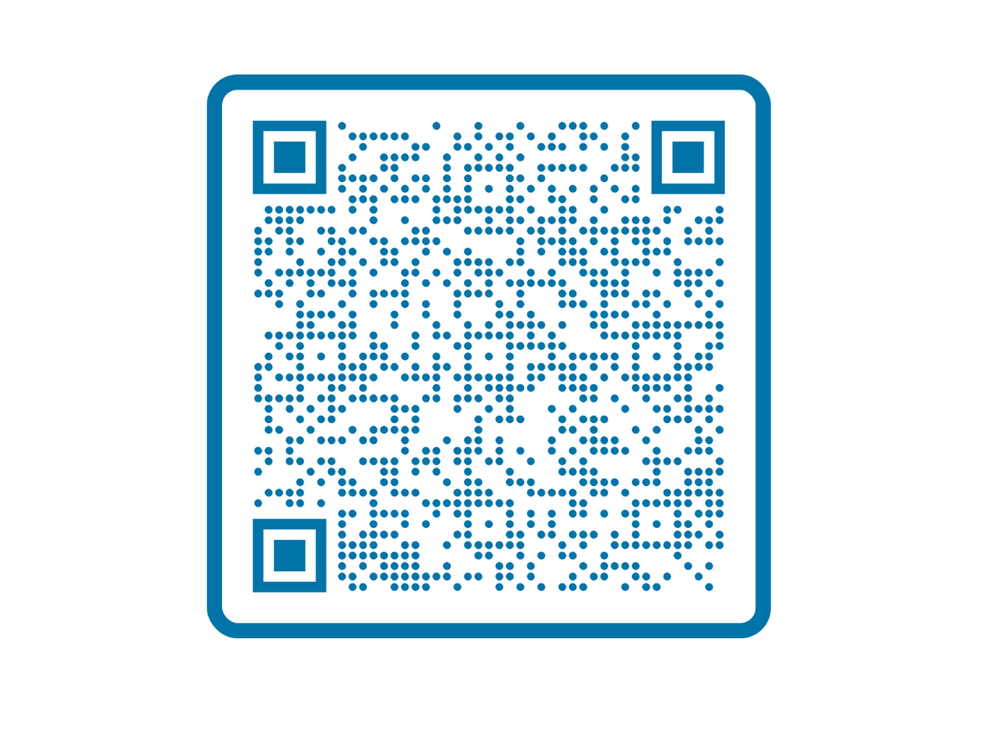
How MedEnvoy Can Help
MedEnvoy can help you transition to mandatory EUDAMED registration and reporting with minimal disruption to your resources and business operations. With our combination of regulatory expertise and technical solutions, we can manage your initial Actor and UDI registrations and provide ongoing lifecycle maintenance to keep your data accurate and compliant.
How we can help
  Eliminate the burden of complex registrations by outsourcing the process
  Simplify compliance with our custom tool GloRIAS
  Streamline and centralize your data management
  Gain direct access to our experienced regulatory experts
Access our EUDAMED Service:

Slide 36
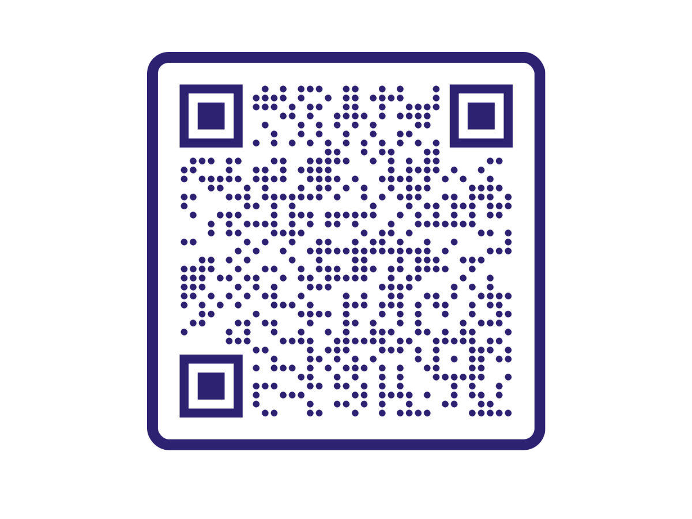
Follow us on Linkedin:

